Slide 1
Clustering (ab-)normal pressure
signals of pipelines
CSIC-5011 Final project
CUI Yiran
ycuiat@connect.ust.hk
Department of Civil and Environmental Engineering

Slide 2
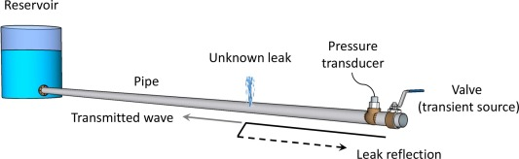
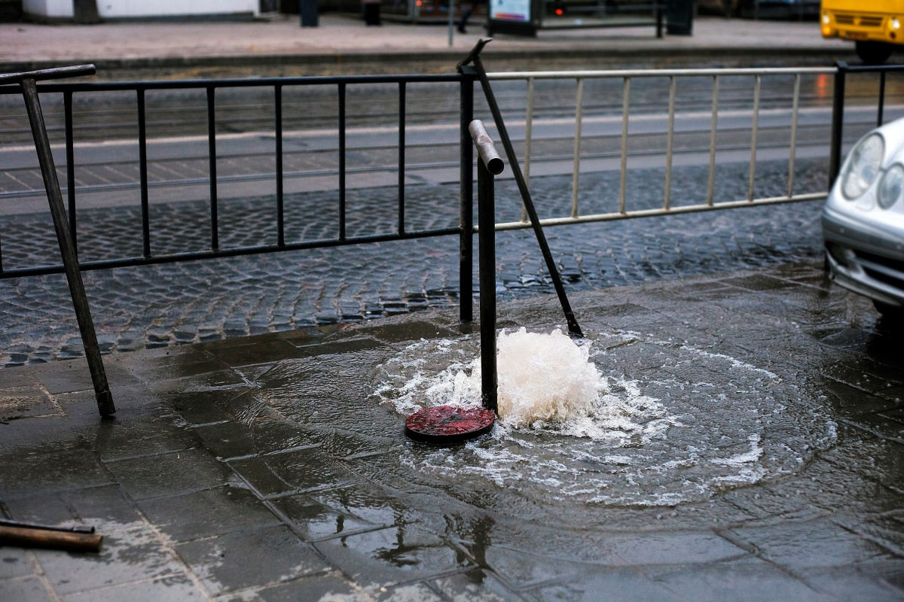
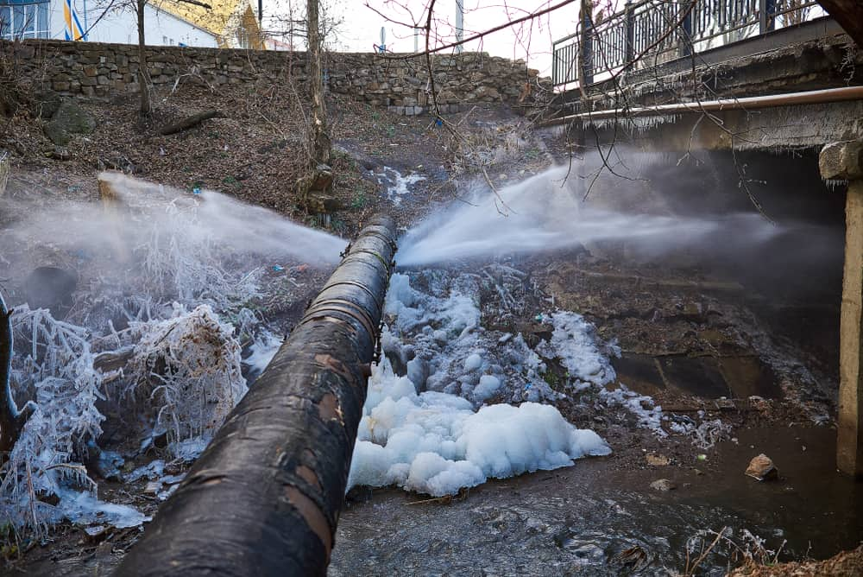
Introduction
Water leakage in urban water supply system is a serious problem that costs considerable economic and labour costs (20-30% supplied water is leaked).
Many methods have been developed to solve the problem, such as transient-based leak detection methods, which use controllable transient waves in pipes to detect leaks, and is fast, cheap and efficient.
Unfortunately we need to make assumptions about the existence of leakage or the number of leakages to apply the transient-based leak detection methods.
Therefore, it will be meaningful if we can know the existence of leakage before we apply leak detection method.
1/18

Slide 3
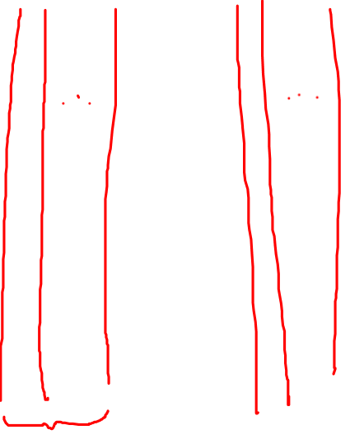

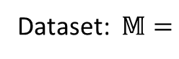
Introduction
Study question:
Is it a way to separate/cluster signals from a dataset containing signals with and without leaks?
Class
(cluster)
one
Class
(cluster)
two
Class
(cluster)
n
Dataset: $𝕄=$
$$⋯⋯$$
2/18

Slide 4
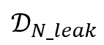
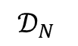
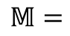
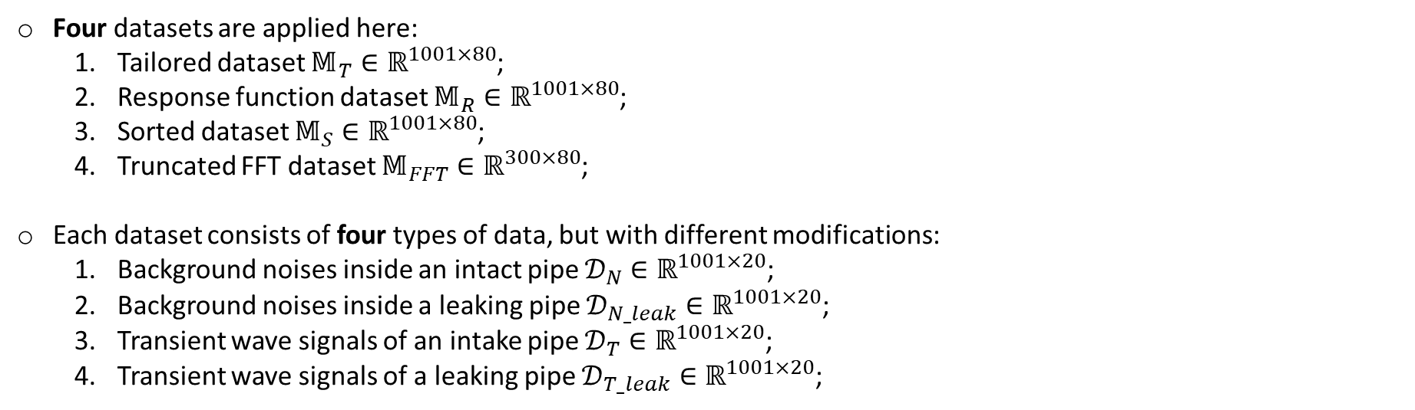
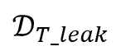
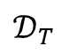
Data description
Four datasets are applied here:
Tailored dataset $𝕄_{T}∈ℝ^{1001×80}$;
Response function dataset $𝕄_{R}∈ℝ^{1001×80}$;
Sorted dataset $𝕄_{S}∈ℝ^{1001×80}$;
Truncated FFT dataset $𝕄_{FFT}∈ℝ^{300×80}$;
Each dataset consists of four types of data, but with different modifications:
Background noises inside an intact pipe $𝒟_{N}∈ℝ^{1001×20}$;
Background noises inside a leaking pipe $𝒟_{N_leak}∈ℝ^{1001×20}$;
Transient wave signals of an intake pipe $𝒟_{T}∈ℝ^{1001×20}$;
Transient wave signals of a leaking pipe $𝒟_{T_leak}∈ℝ^{1001×20}$;
$$𝕄=$$
$$𝒟_{N}$$
$$𝒟_{N_leak}$$
$$𝒟_{T}$$
$$𝒟_{T_leak}$$
3/18

Slide 5
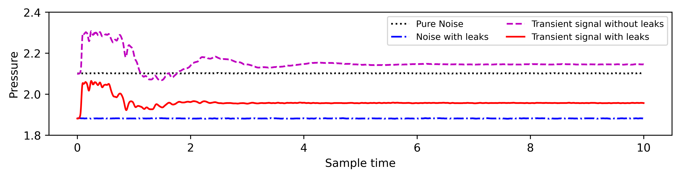
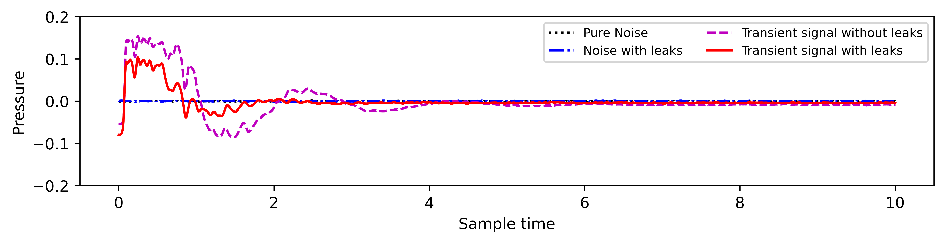
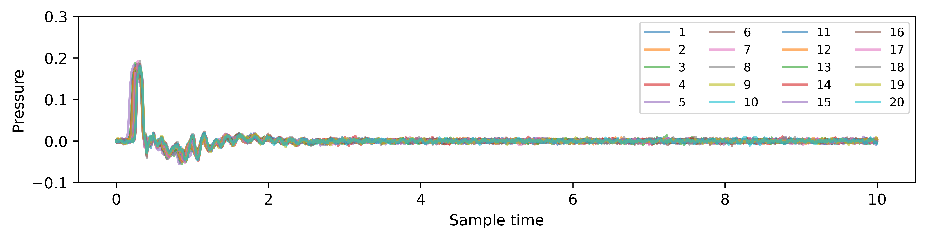
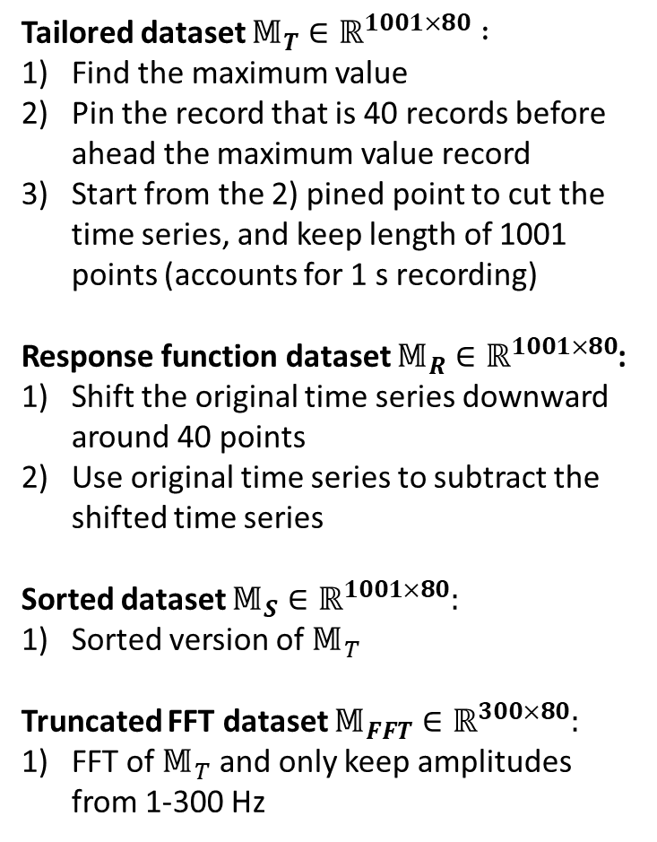
Data description
Tailored dataset $𝕄_{T}∈ℝ^{1001×80} :$
Find the maximum value
Pin the record that is 40 records before ahead the maximum value record
Start from the 2) pined point to cut the time series, and keep length of 1001 points (accounts for 1 s recording)
Response function dataset $𝕄_{R}∈ℝ^{1001×80}$:
Shift the original time series downward around 40 points
Use original time series to subtract the shifted time series
Sorted dataset $𝕄_{S}∈ℝ^{1001×80}:$
Sorted version of $𝕄_{T}$
Truncated FFT dataset $𝕄_{FFT}∈ℝ^{300×80}:$
FFT of $𝕄_{T}$ and only keep amplitudes from 1-300 Hz
Sampling rate: 1 kHz
4/18

Slide 6
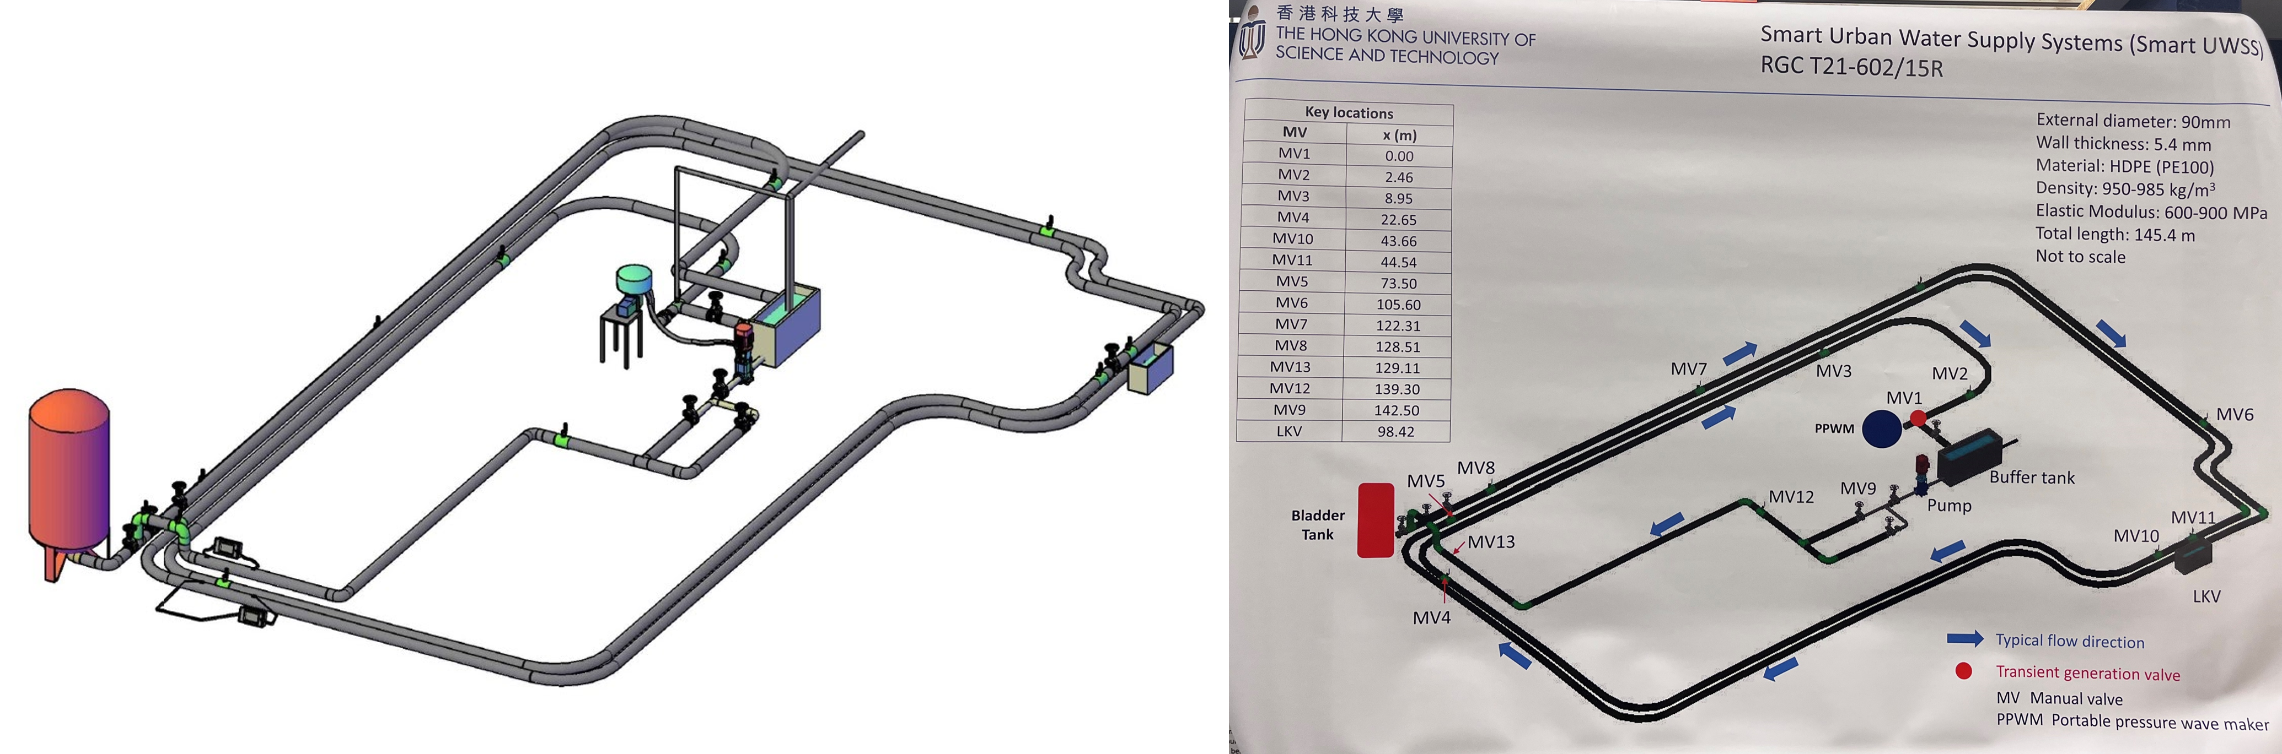
Experimental description
Data is sampled from Water-Lab at HKUST [1]
Transient wave is generated by manual valve closure
A controllable leak point (LKV) is located at 98.42 m away from the transient generation valve (MV1)
Data is sampled at MV4
Experimental procedures can be found in [2]
[1] Smart UWSS.\ (2023, May 17). {\it Controlled facility 1: HKUST lab pipeline.} Smart Urban Water Supply System. URL:\url{https://sites.google.com/view/smartuwss/facilities/Facilities_1}
[2] Wang, X., Lin, J., Keramat, A., Ghidaoui, M.S., Meniconi, S., \& Brunone, B.(2019c). Matched-Field Processing for Leak Detection in a Viscoelasticity Pipe: An Experimental Study. Mechanical Systems and Signal Processing, 124, 459-478
5/18

Slide 7
Methodology
To answer the study question, Principle component analysis (PCA), Local tangent space alignment (LTSA), and Laplacian locally linear embedding (Laplacian LLE) are applied.
To have a better understanding on the graph, the second eigenvalue analysis of unnormalized graph Laplacian (Fiedler's theorem) and eigenvector analysis of normalized graph Laplacian (Cheeger`s Inequality) are applied.
Ncut is also conducted as illustrations.
More details can be found in [3].
Study question:
Is it a way to separate/cluster signals from a dataset containing signals with and without leaks?
6/18
[3] Yao Yuan\ (2023). \textit{Geometric and Topological Data Reduction: A Mathematical Introduction to Data Science}. URL:\url{https://yao-lab.github.io/book datasci/}

Slide 8
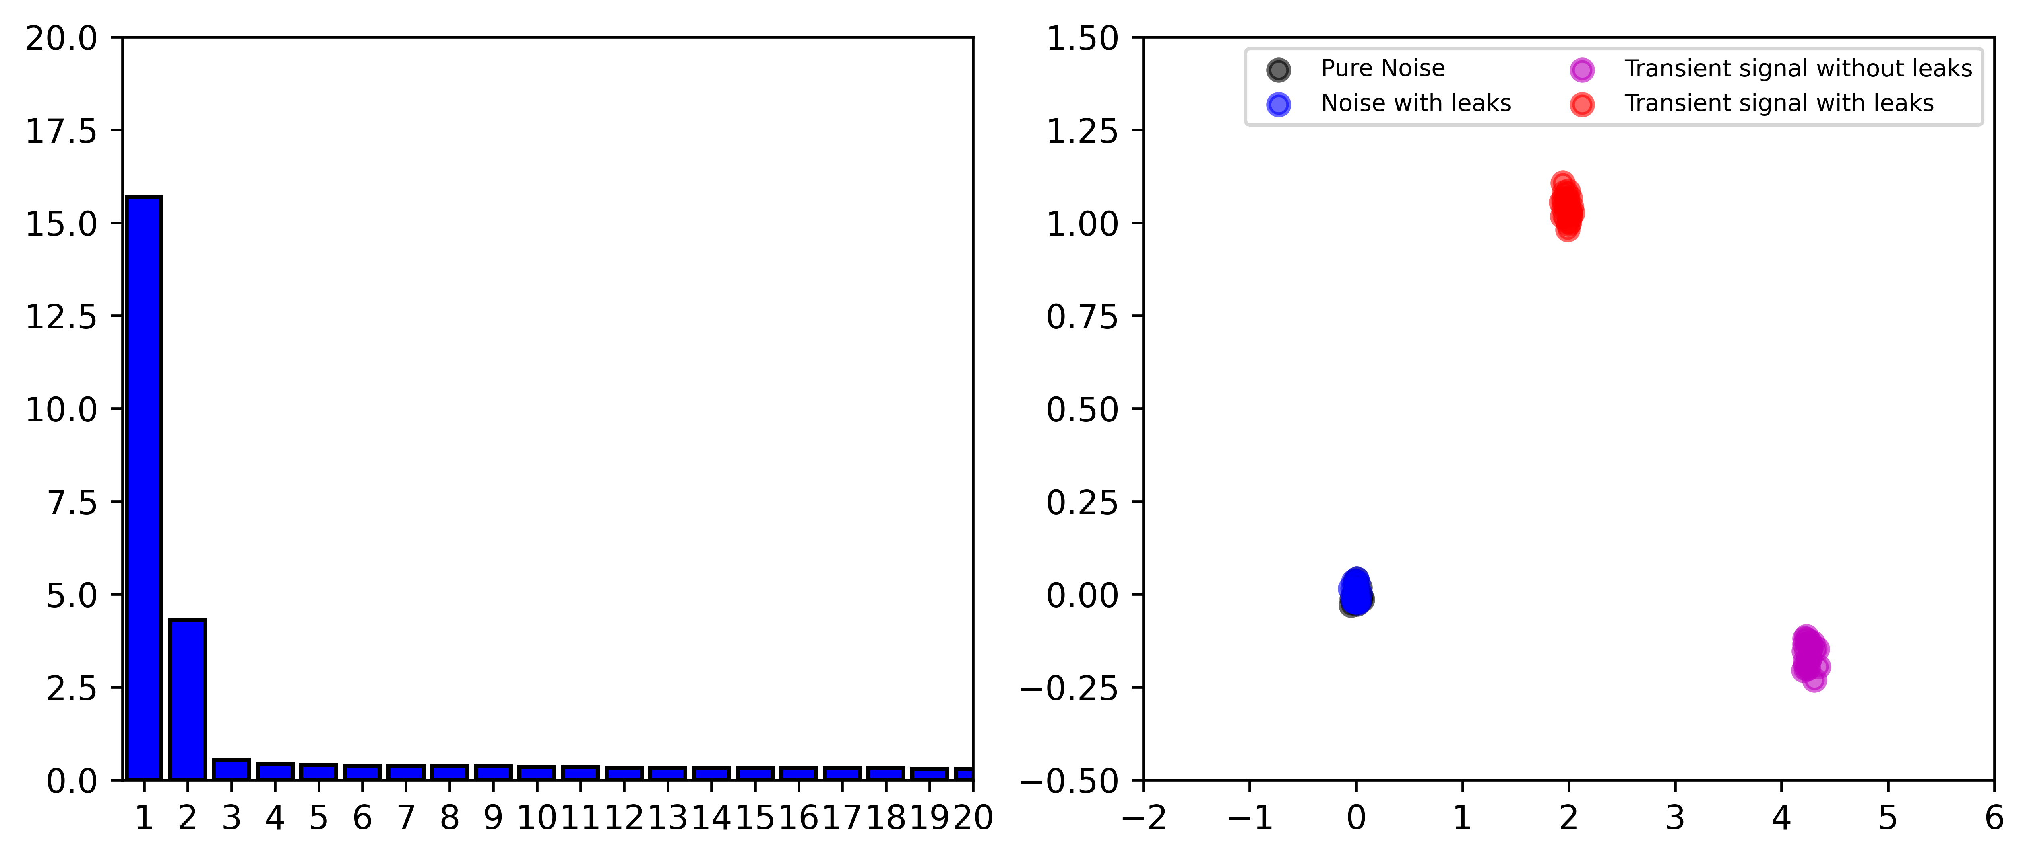
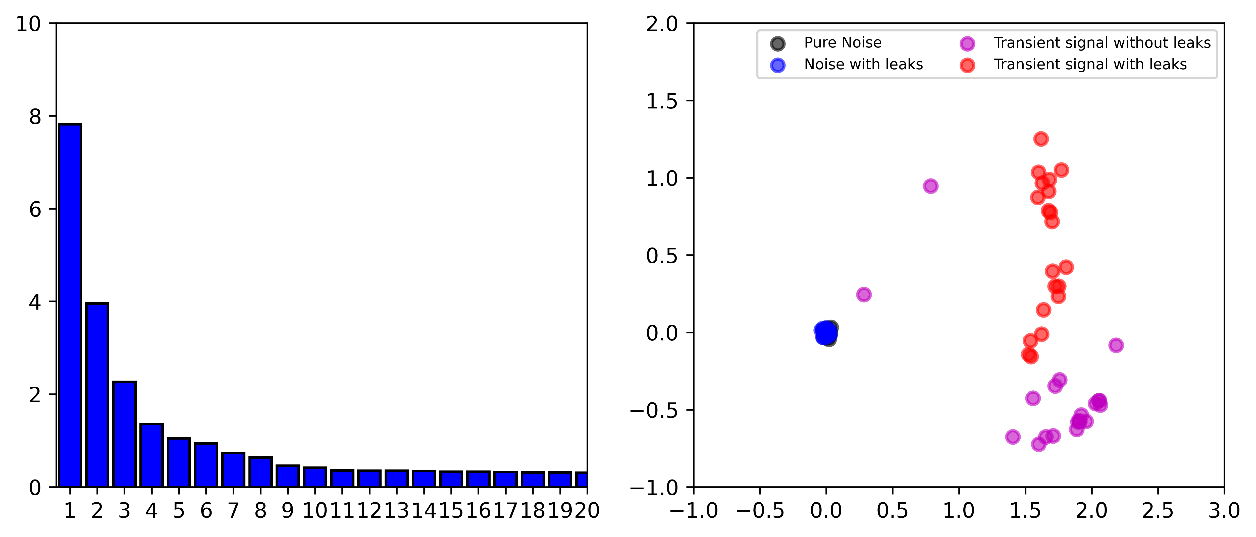
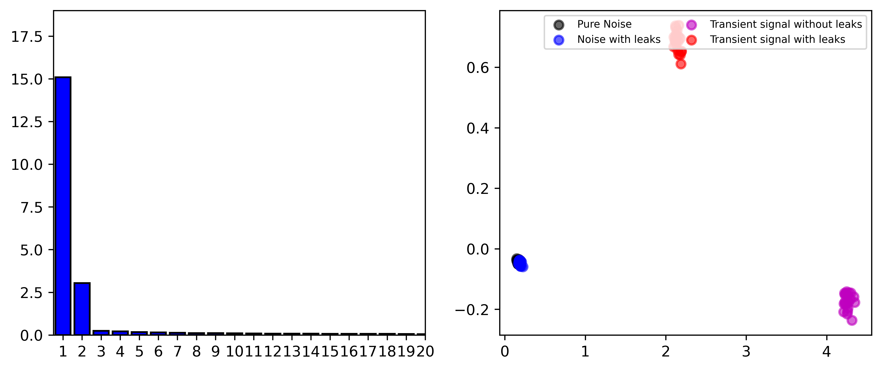
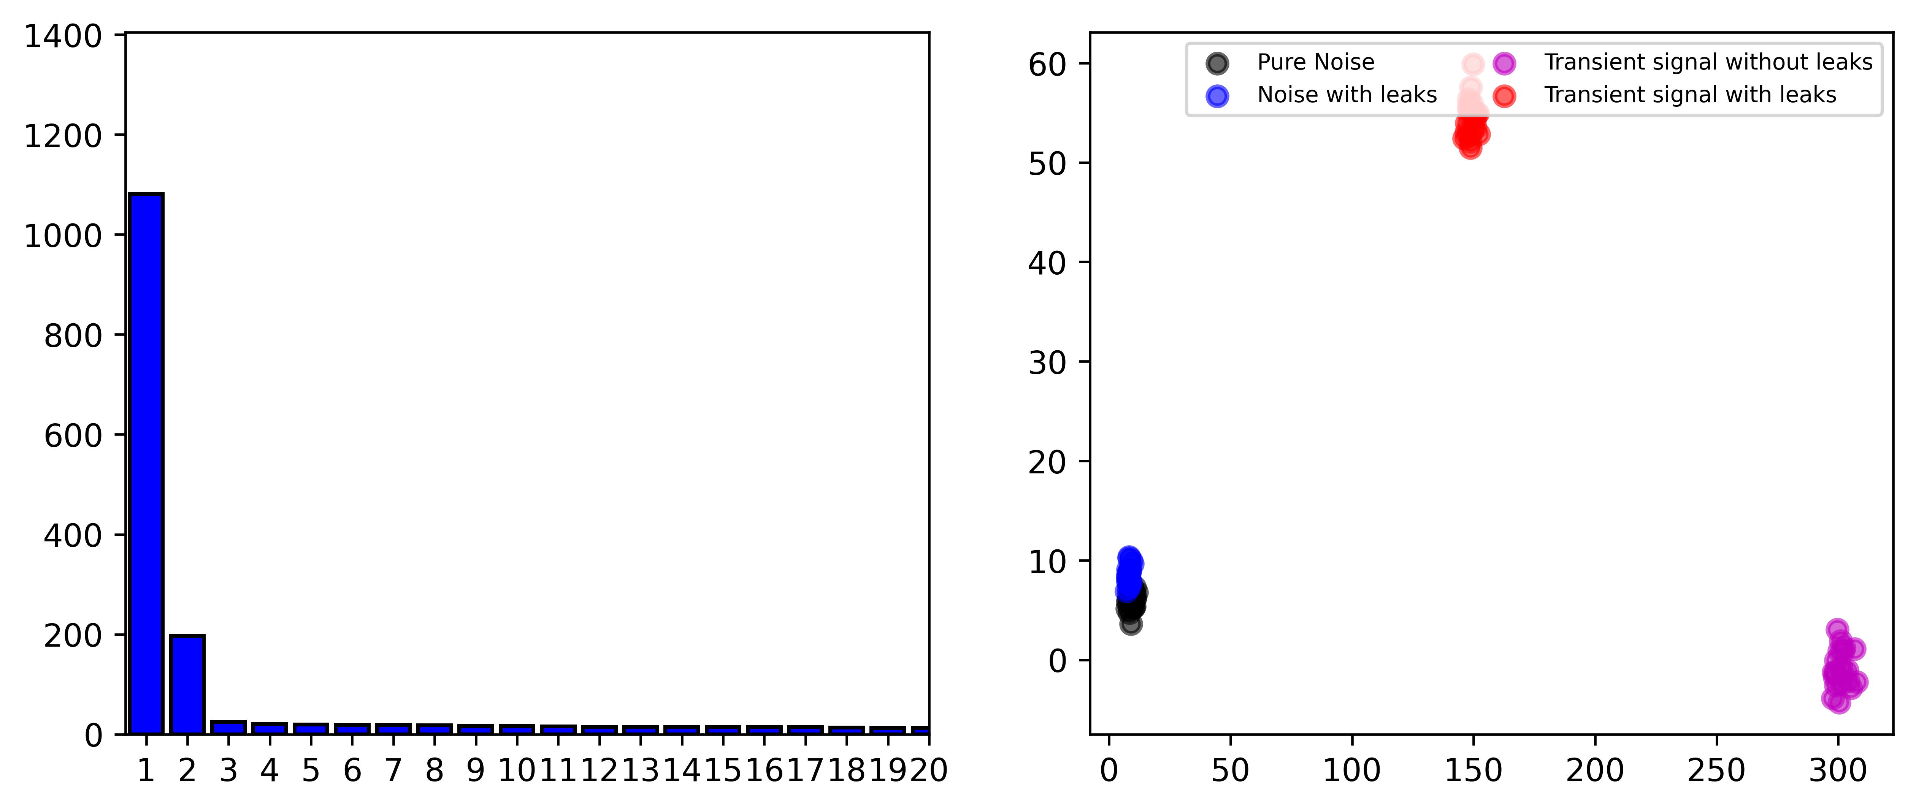
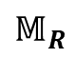
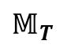
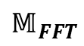
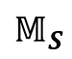
Results and discussion
PCA:
$$𝕄_{T}$$
$$𝕄_{R}$$
$$𝕄_{S}$$
$$𝕄_{FFT}$$
7/18

Slide 9
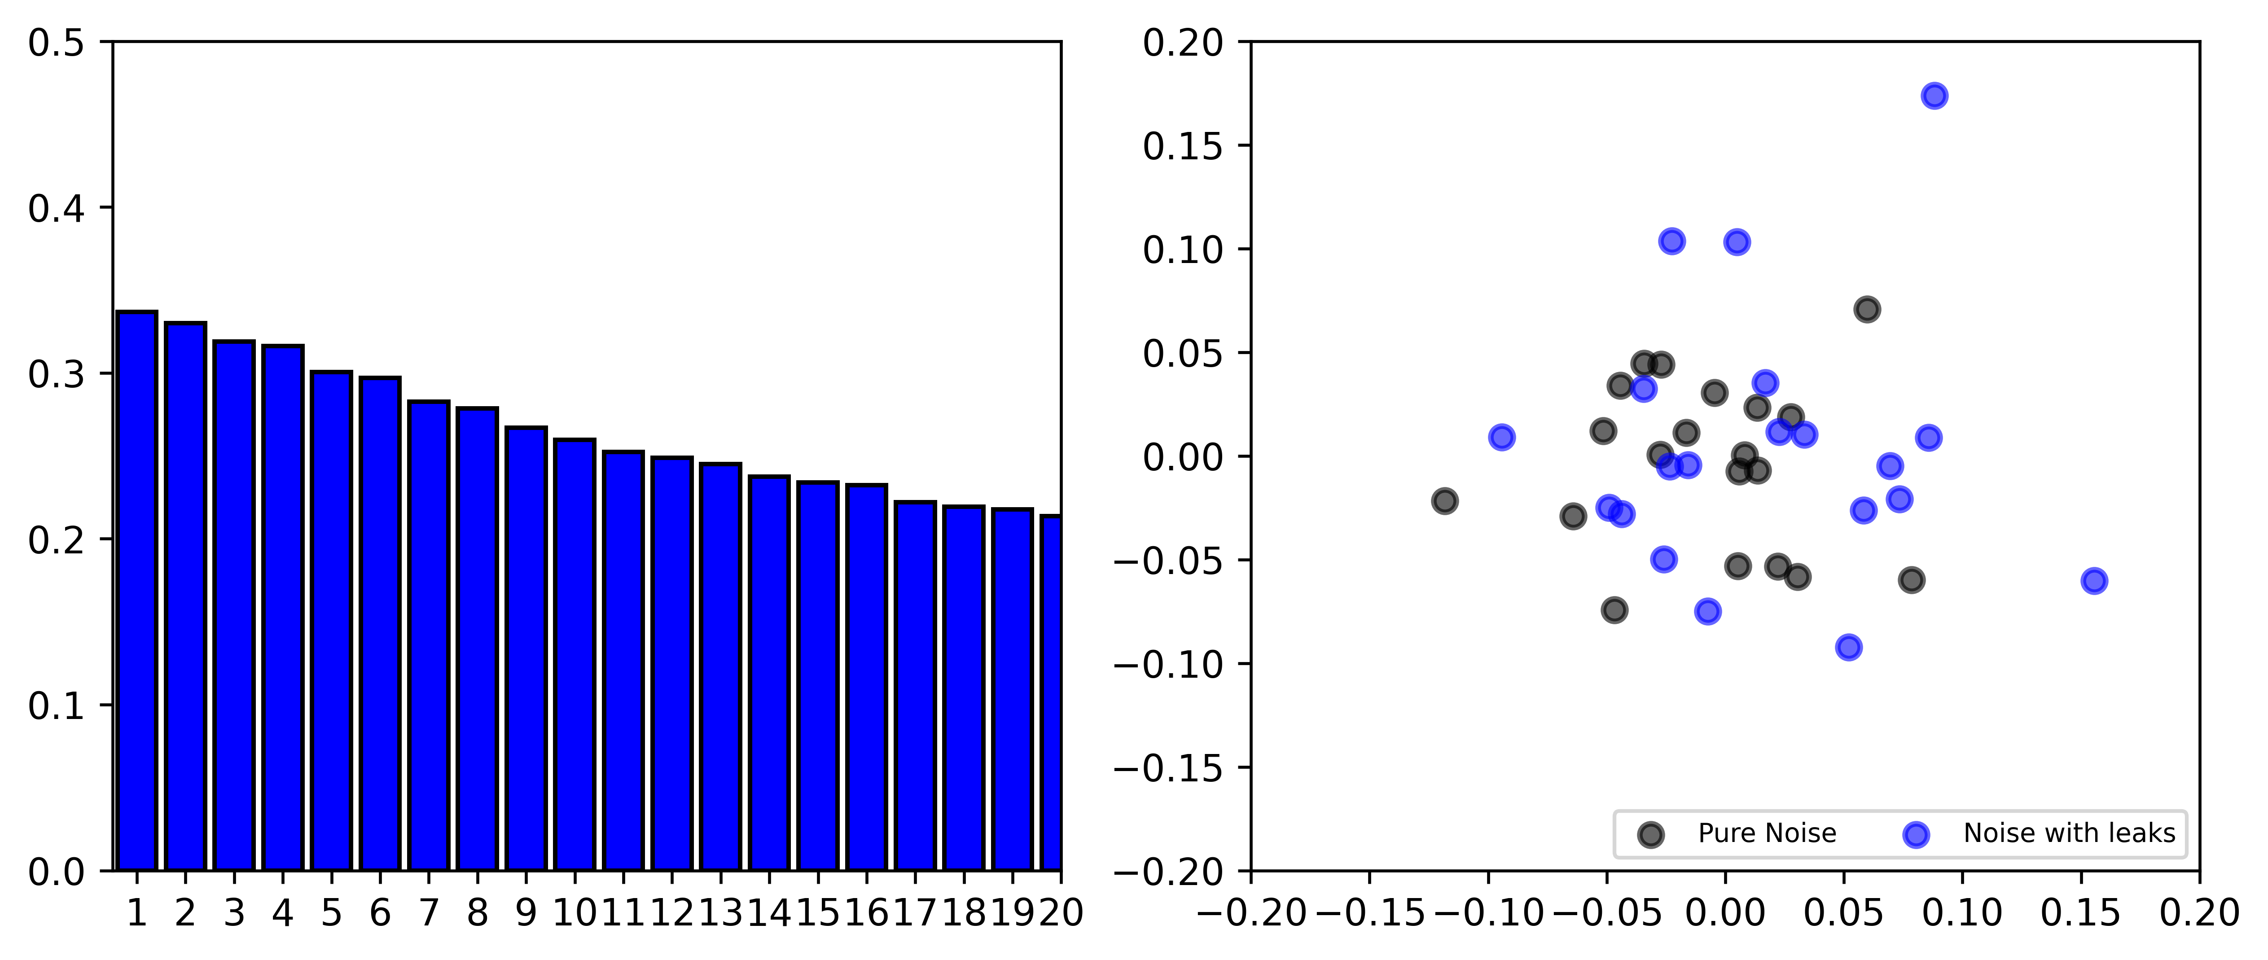
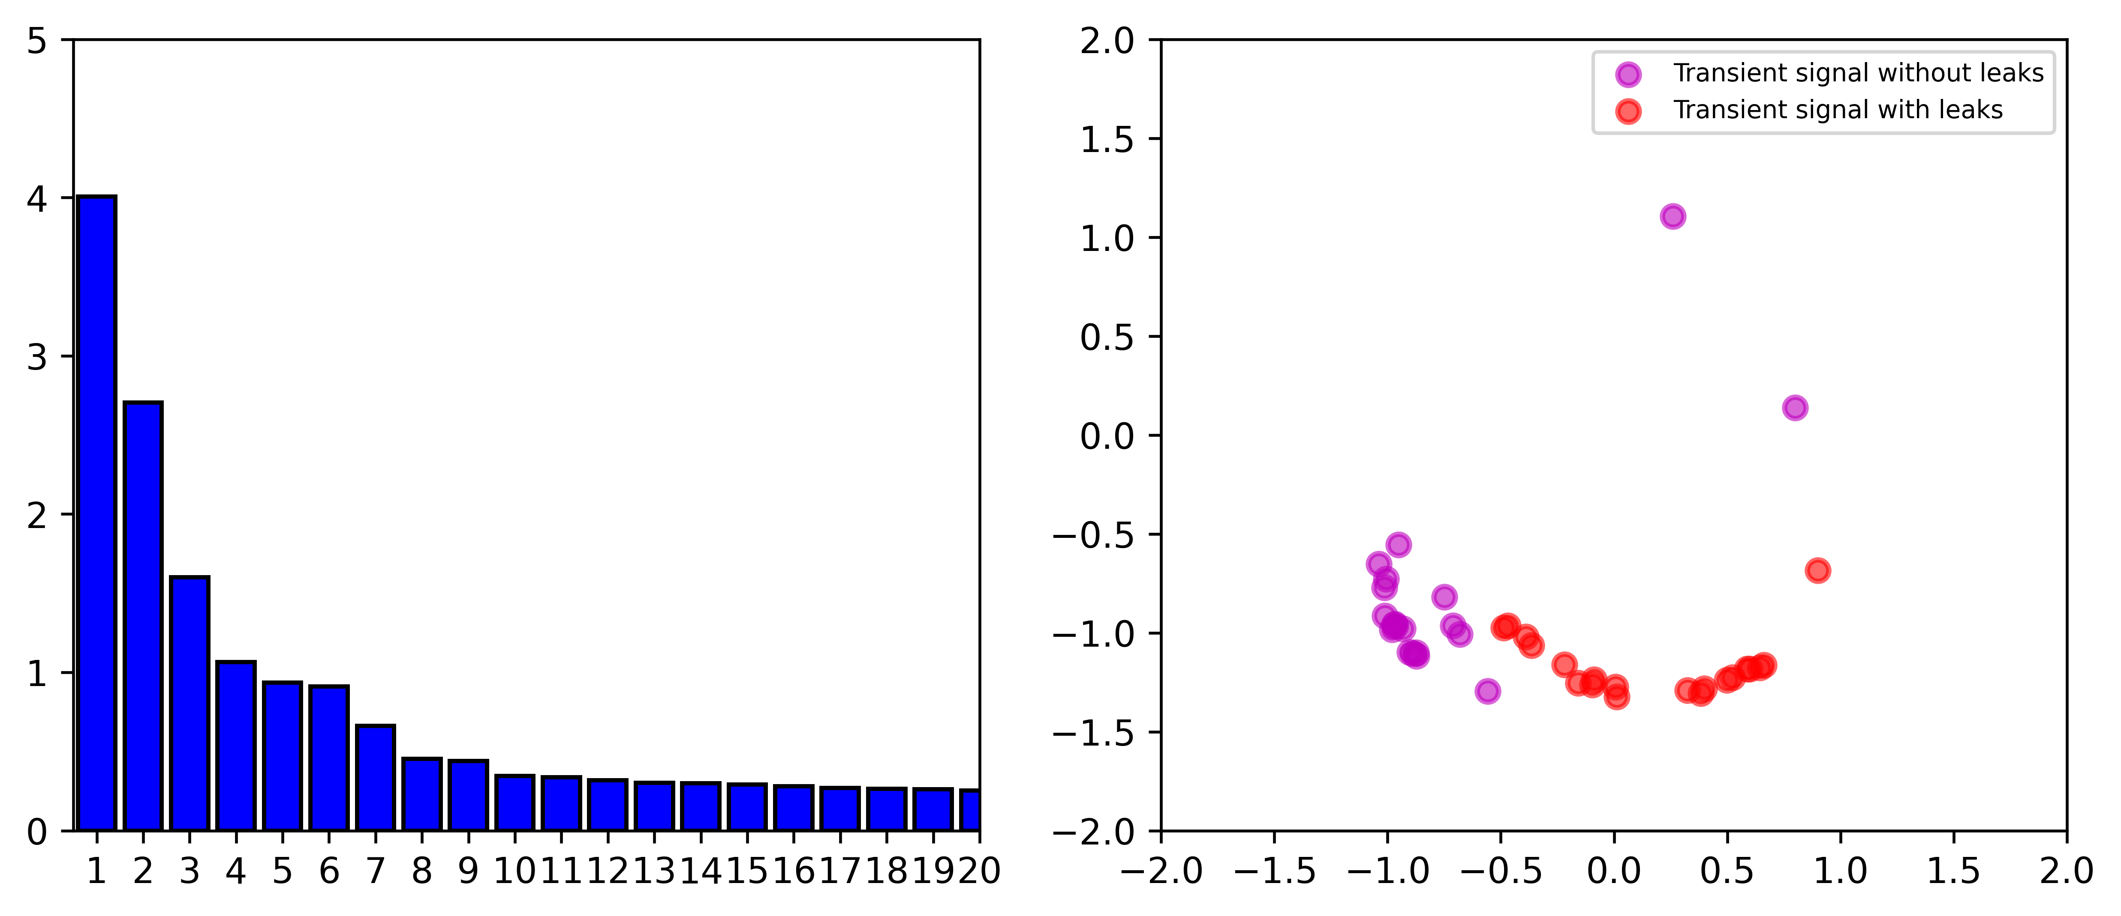
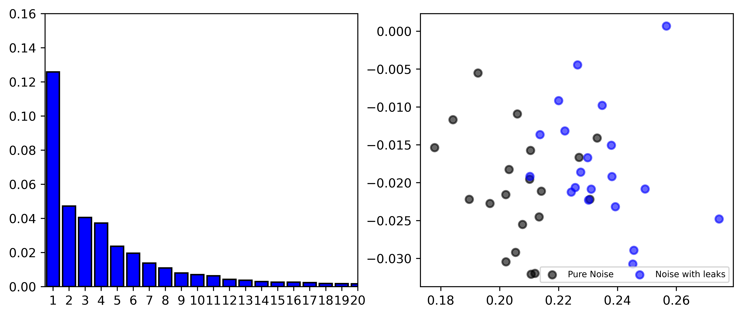
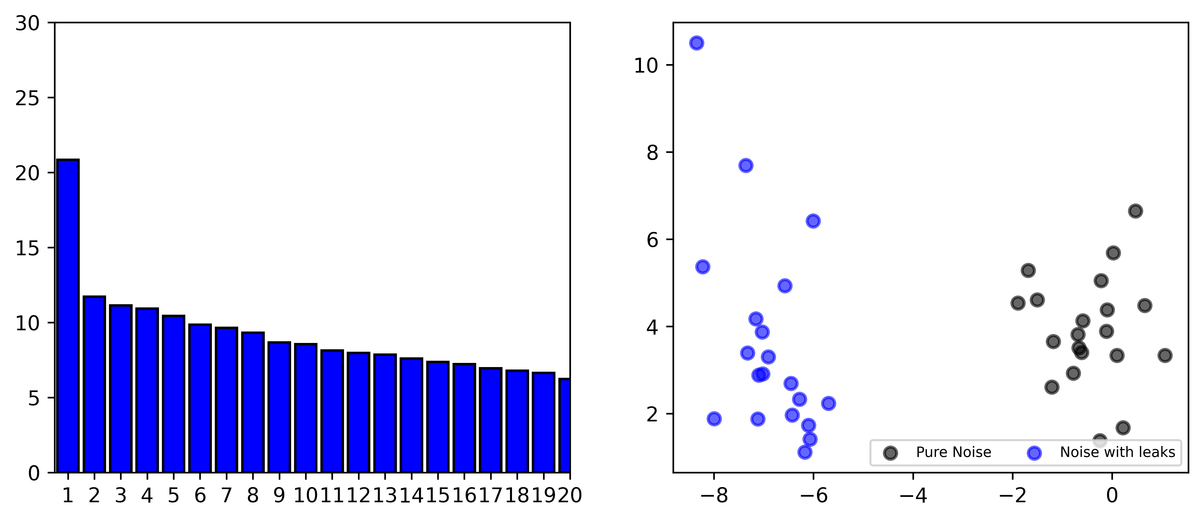




Results and discussion
PCA:
Noise data in $𝕄_{T}$ and $𝕄_{R}$
Transient data in $𝕄_{R}$
Noise data in $𝕄_{S}$
Noise data in $𝕄_{FFT}$
8/18

Slide 10
Results and discussion
PCA:
Transient data is significantly different from noise data
Two types of noise data is entangled
Leak may induce linear changes onto the background noise at low-frequency range (1-300) Hz
9/18

Slide 11
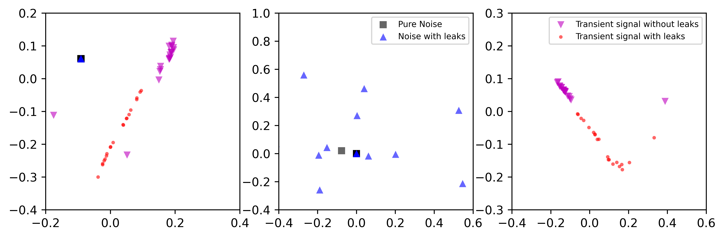
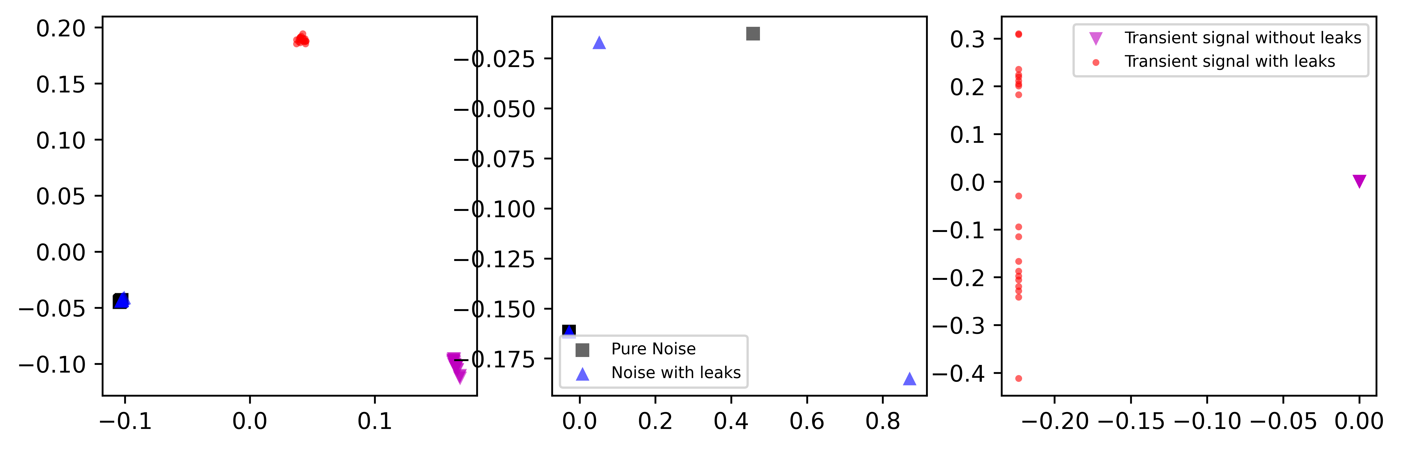
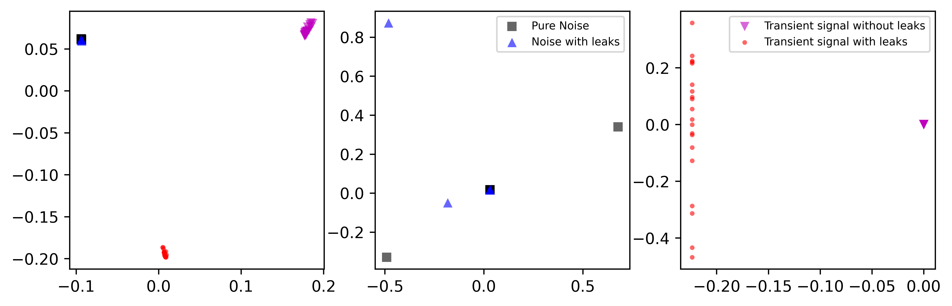
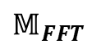
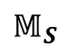
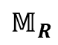
Results and discussion
LTSA:
$$𝕄_{R}$$
$$𝕄_{S}$$
$$𝕄_{FFT}$$
10/18

Slide 12
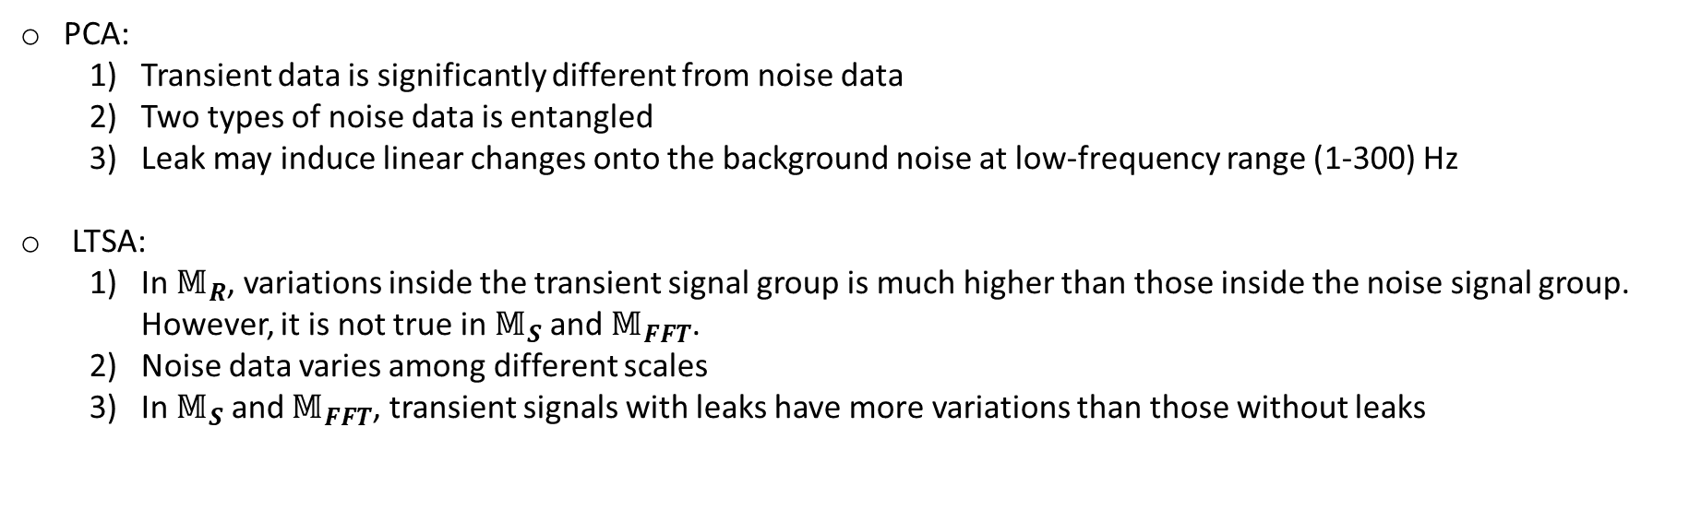
Results and discussion
PCA:
Transient data is significantly different from noise data
Two types of noise data is entangled
Leak may induce linear changes onto the background noise at low-frequency range (1-300) Hz
LTSA:
In $𝕄_{R}$, variations inside the transient signal group is much higher than those inside the noise signal group. However, it is not true in $𝕄_{S}$ and $𝕄_{FFT}$.
Noise data varies among different scales
In $𝕄_{S}$ and $𝕄_{FFT}$, transient signals with leaks have more variations than those without leaks
11/18

Slide 13
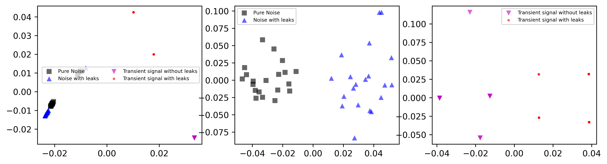
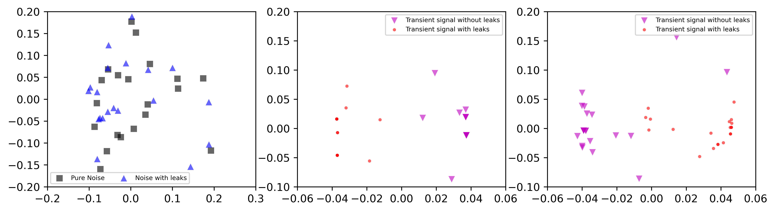
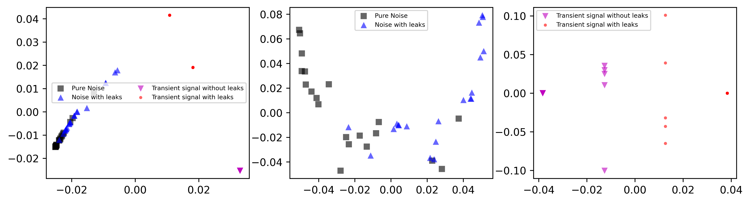
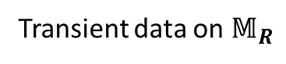
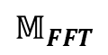
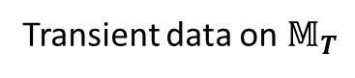
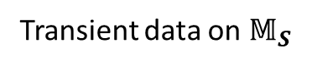
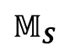
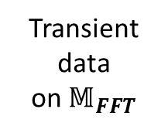
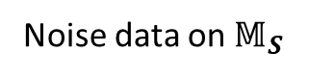
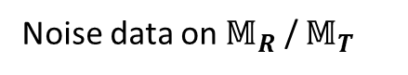
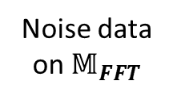
Results and discussion
12/18
N=25
Laplacian LLE:
Noise data on $𝕄_{R}$ / $𝕄_{T}$
Transient data on $𝕄_{T}$
Transient data on $𝕄_{R}$
$$𝕄_{FFT}$$
N=5
N=22
N=22
N=25
Noise data
on $𝕄_{FFT}$
$$𝕄_{S}$$
Noise data on $𝕄_{S}$
Transient data on $𝕄_{S}$
N=25
N=25
N=25
N=25
Transient data
on $𝕄_{FFT}$

Slide 14
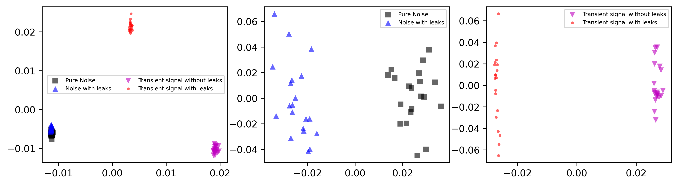
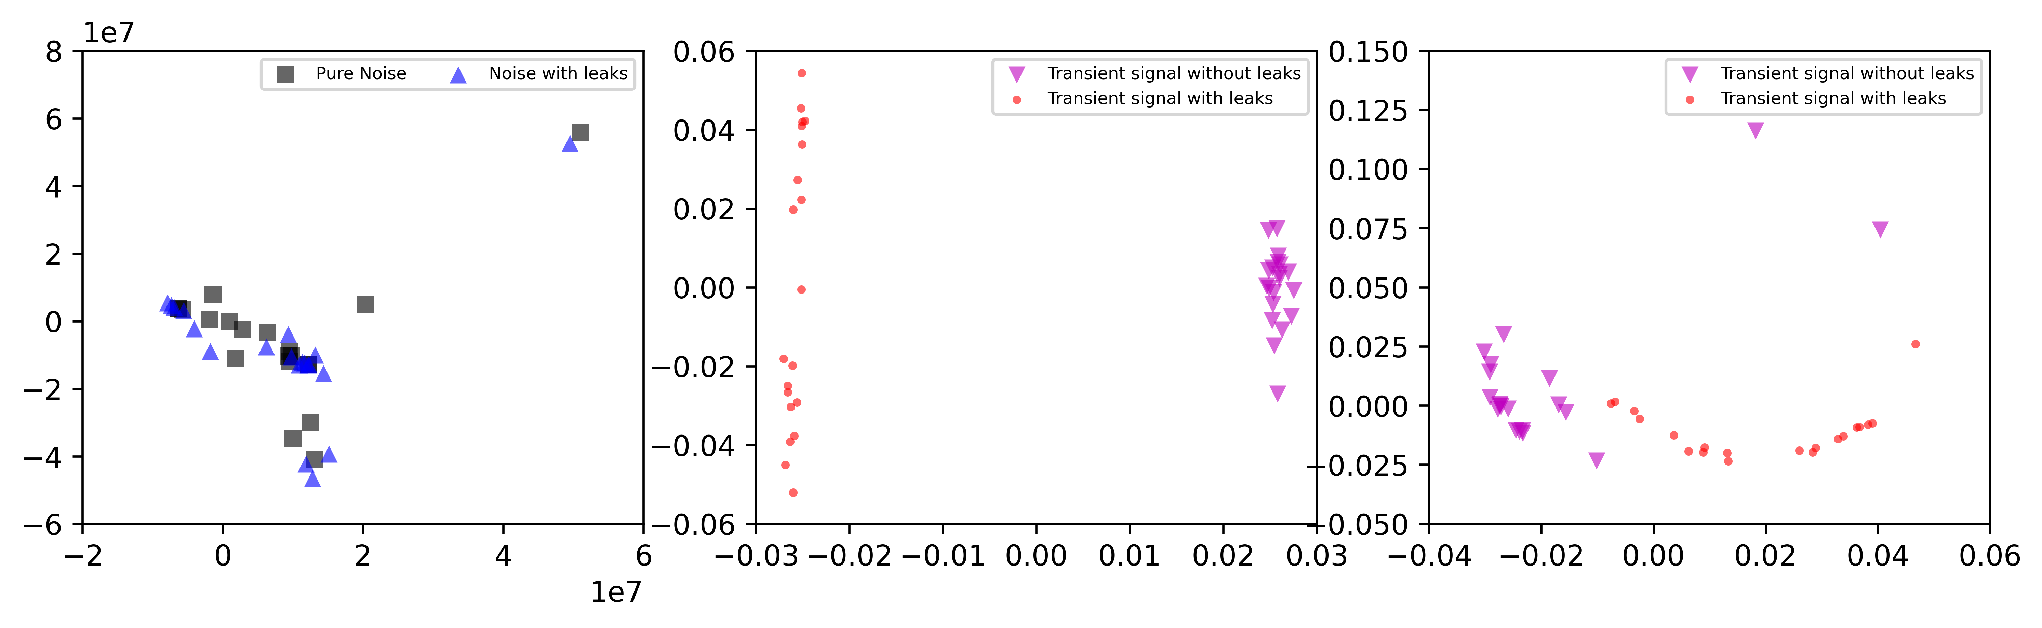

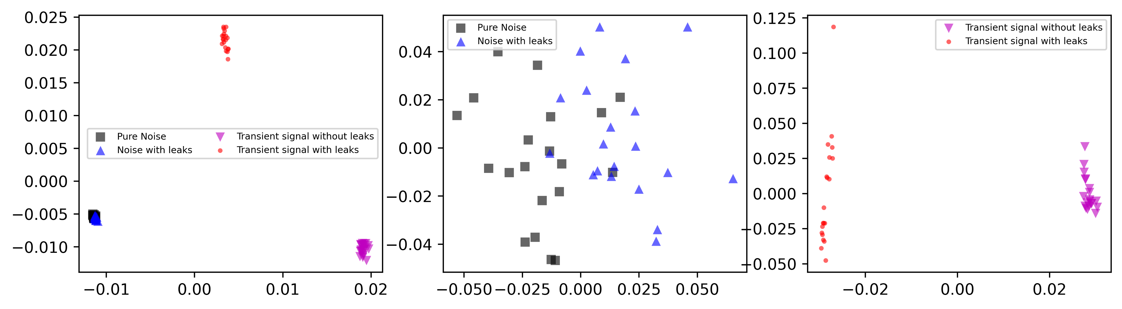












Results and discussion
13/18
Laplacian LLE:
Noise data on $𝕄_{R}$ / $𝕄_{T}$
Transient data on $𝕄_{T}$
Transient data on $𝕄_{R}$
$$𝕄_{FFT}$$
$$γ={10}^{−10}$$
$γ$=520
$γ$=0.01
$γ$=0.01
$$γ={10}^{−5}$$
Noise data
on $𝕄_{FFT}$
$$𝕄_{S}$$
Noise data on $𝕄_{S}$
Transient data on $𝕄_{S}$
$$γ=0.1$$
$$γ={10}^{−5}$$
$$γ={10}^{−10}$$
Transient data
on $𝕄_{FFT}$
$$γ={10}^{−5}$$

Slide 15

Results and discussion
PCA:
Transient data is significantly different from noise data
Two types of noise data is entangled
Leak may induce linear changes onto the background noise at low-frequency range (1-300) Hz
LTSA:
In $𝕄_{R}$, variations inside the transient signal group is much higher than those inside the noise signal group. However, it is not true in $𝕄_{S}$ and $𝕄_{FFT}$.
Noise data varies among different scales
In $𝕄_{S}$ and $𝕄_{FFT}$, transient signals with leaks have more variations than those without leaks
Graph Laplacian LLE:
Graph Laplacian can help to clusters
By control the number of neighbours or weights, the performance of graph Laplacian LLE can be modified
14/18

Slide 16









Results and discussion
15/18
Let’s get deeper of the Laplacian graph:
Unnormalized graph Laplacian (Fiedler’s theorem):
$$𝕄_{FFT}$$
Noise data on $𝕄_{R}$ / $𝕄_{T}$
Transient data on $𝕄_{T}$
Transient data on $𝕄_{R}$
Noise data
on $𝕄_{FFT}$
$$𝕄_{S}$$
Noise data on $𝕄_{S}$
Transient data on $𝕄_{S}$
Transient data
on $𝕄_{FFT}$

Slide 17












Results and discussion
Let’s get deeper of the Laplacian graph:
Normalized graph Laplacian (Cheeger’s Inequality):
Full of $𝕄_{S}$
Full of $𝕄_{FFT}$
Noise of $𝕄_{FFT}$
Transient of $𝕄_{FFT}$
Noise of $𝕄_{S}$
Transient of $𝕄_{S}$
16/18

Slide 18






Results and discussion
Let’s get deeper of the Laplacian graph:
Normalized graph Laplacian (Cheeger’s Inequality):
Noise of $𝕄_{S}$
Noise of $𝕄_{FFT}$
Noise of $𝕄_{S}$
Noise of $𝕄_{FFT}$
17/18

Slide 19
Conclusions
The question ’Is it a way to separate/cluster signals from a dataset 211 containing signals with and without leaks’ ?
Yes, we do can cluster different types of data;
The final cluster highly depends on the quality of the dataset applied and the pre-knowledge of the processed data.
With proper knowledge of the data and of the setting of the number of neighbors or weights, the meaning of clusters can be understood.
Transient data is better than noise data in cluster;
The existence of noise data seems to make low-frequency parts of steady pressure (1-300 Hz) vary a lot.
All data, codes and report can be found in:
https://drive.google.com/drive/folders/1ygImku3AsiVB9mamjkzqyPsLHnm9X9nt?usp=share_link
18/18

Slide 20
Thanks for your interests
Comments are welcomed
ycuiat@connect.ust.hk

